Slide 1
Liner Regression - Problem Statement
A Chinese automobile company Geely Auto aspires to enter the US market by setting up their manufacturing unit there and producing cars locally to give competition to their US and European counterparts.
They have contracted an automobile consulting company to understand the factors on which the pricing of a car depends. Specifically, they want to understand the factors affecting the pricing of cars in the American marketing, since those may be very different from the Chinese market. Essentially, the company wants to know:
Which variables are significant in predicting the price of a car
How well those variables describe the price of a car
Based on various market surveys, the consulting firm has gathered a large dataset of different types of cars across the Americal market.
Goal of this case-study
You are required to model the price of cars with the available independent variables. It will be used by the management to understand how exactly the prices vary with the independent variables. They can accordingly manipulate the design of the cars, the business strategy etc. to meet certain price levels. Further, the model will be a good way for the management to understand the pricing dynamics of a new market.
Data Preparation
There is a variable named CarName which is comprised of two parts - the first word is the name of 'car company' and the second is the 'car model'. For example, chevrolet impala has 'chevrolet' as the car company name and 'impala' as the car model name. You need to consider only company name as the independent variable for the model building.

Slide 2
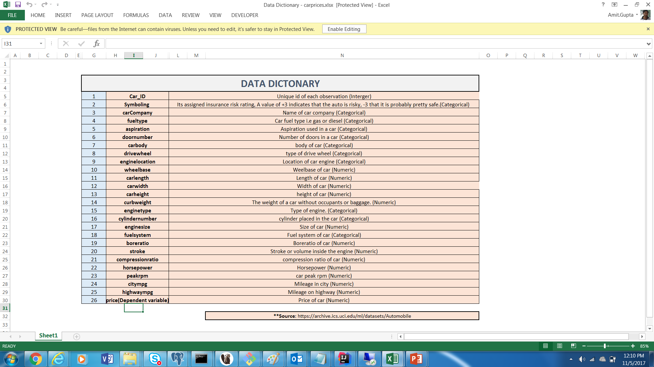

Slide 3
Start
Make a first model using lm
Load CSV
Execute the stepAIC with both direction
Convert into factors
Segregate the car name into company name and model
Keep checking the adjusted R^2 , P value and VIF
Check for missing value
Predict on the test data and check the R^2
Check for duplicate value
Segregate data into test & training dataset
End

